Slide 1


BGSW- SJCE Academy Connect
Autosar Crypto Stack overview
Sathyamoorthy Ilangovan

Slide 2


Crypto stack overview
Agenda
Need of Crypto stack
Crypto Stack Architecture
Secure Onboard Communication
02

Slide 3

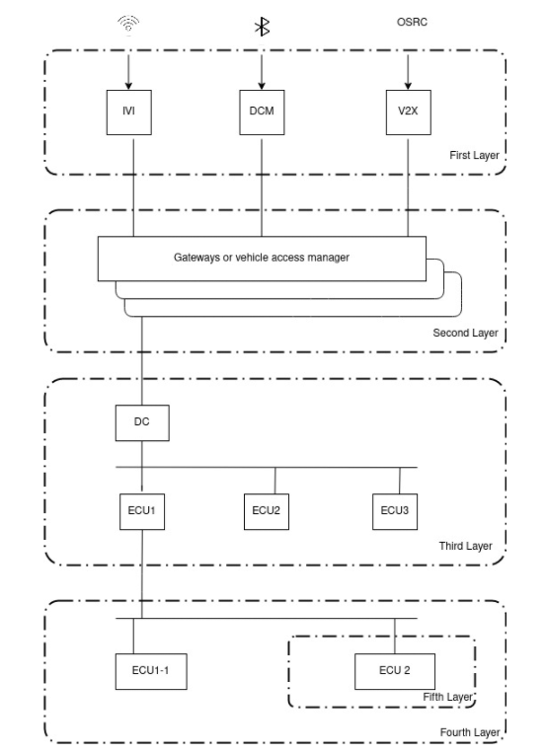
Crypto stack overview
Need of Crypto stack
Layer 1
The first layer is the vehicle access point layer that can be secured by adding firewalls and intrusion detection.
01
Layer 2
The second layer is the in-vehicle network interfaces that can be secured by adding firewalls, key managers, filtering routing, or delimitating interface zones.
02
Layer 3
03
The third layer is the public inner-vehicle network that can be secured principally by message authentication protections.
04
05
Layer 4
Layer 5
The fourth layer is the private inner-vehicle network that can be secured principally by message authentication protections.
The fifth layer is the ECU by itself that can be secured principally by anti-tampering security mechanisms.
04

Slide 4
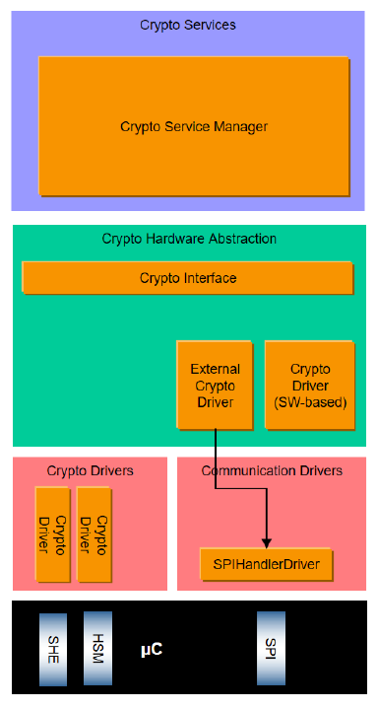
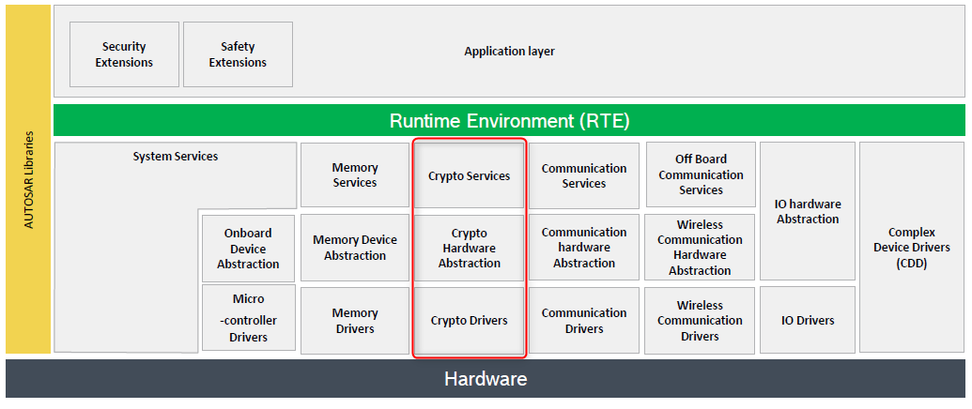
Crypto stack overview
Autosar Architecture – Crypto stack
04

Slide 5
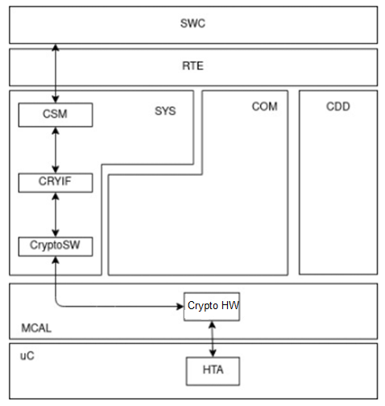
Crypto stack overview
Control Flow
Crypto Service Manager (CSM): This module communicates with the SWCs to offer services and handlers to the cryptography operations
CSM
Crypto Interface (CRYIF): This module enables CSM to access Crypto Driver features based on standardized APIs.
CRYIF
Crypto
Driver
Crypto Driver (CryptoSW and CryptoHw): These modules are the ones performing the cryptographic functions. CryptoSW uses SW libraries whereas CryptoHW uses HW capabilities (SHE, HSM, TPM, …).
05

Slide 6
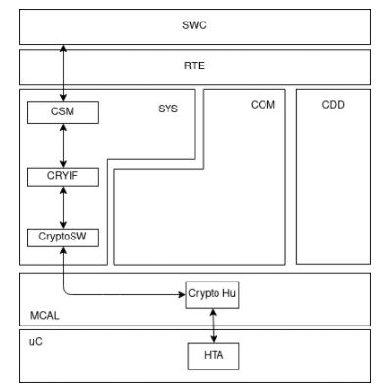
Crypto stack overview
CSM
CSM primitives define each job type based on:
Crypto predefined generic algorithms.
MAC generation or verification.
A digital signature generation or verification.
Encryption/Decryption of symmetric keys.
Encryption/Decryption of asymmetric keys.
Hashing, random number generation, etc.
Specific algorithm configuration
Algorithm family (AES, RDS, …)
Algorithm mode.
Job processing mode.
Length of input/output data.
CSM offer services and handlers to the following cryptography operations:
Random number and hashing generation.
Data encryption/decrypt.
MACs.
Digital Signature.
Models of operations based on “jobs”.
Asynchronous/Synchronous process of jobs.
Generation, derivation, and exchange of keys.
Freshness counting
Crypto Service Manager (CSM) is the service module from BSW that manages the crypto services to secure data and processes.
A CSM Job is the abstraction of CSM keys, CSM queues, and CSM primitive types. CSM has the properties to be able to dispatch jobs based on priorities. The jobs can be synchronous or asynchronous, Synch jobs wait for the returning value of a finished call and do not use callbacks; whereas async jobs are inserted into the queue based on their priority when the respective callback is finished.
06

Slide 7
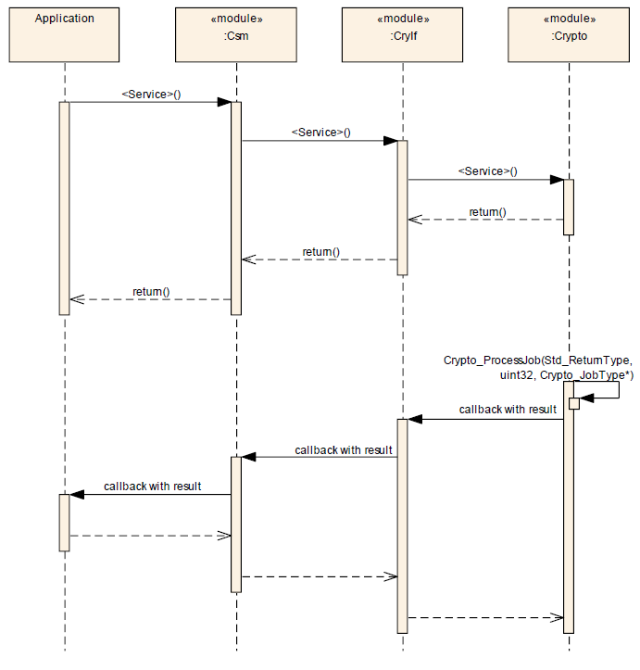
Crypto stack overview
CSM
The crypto stack communication is as follows:
One SWC asks for a CSM service using the API Csm_Encrypt(). This API use Job IDs to identify every encryption process.
CSM adds the required job to one of the available CSM queues, the scheduler processes this job based on its priority.
Then CSM executes Csm_MainFunction() to transmit the selected job to lower modules.
The job is transmitted to the Crypto Driver, which processes it, and returns a specific value to let CSM know the result.
CSM returns the result to the SWC while removing the processed job from the queue.
07
Notes:
Based on the exchange of information on the security stack, each CSM key is mapped to a CRYIF key and a Crypto Driver key.
CSM Queues are mapped based on the Crypto Driver, CRYIF uses one channel for each CSM Queue to a Crypto Driver in order to process one job at a time.

Slide 8
Crypto stack overview
CRYIF
The CRYIF is enclosed by the upper layer CSM and by the lower layer CRYPTO.
It receives requests from the CSM and maps them to the appropriate cryptographic operation in the CRYPTO.
CRYIF forwards the requests given by CSM to the particular CRYPTO. Callback notifications inform about the outcome in case the request was asynchronous.
The CRYIF can operate several CRYPTO modules. There could be, for example, one CRYPTO module for an external cryptographic hardware module and one CRYPTO module holding a cryptographic software library.
The CRYIF provides a generic interface so that the access from the CSM does not need to distinguish between the actual CRYPTO implementations.
08

Slide 9
Crypto stack overview
Crypto Driver
A CRYPTO typically holds the actual cryptographic implementations and supports key storage, key configuration, and key management for cryptographic services.
It can have one or more Crypto Driver Objects, with separate workspaces. Each Crypto Driver Object can provide arbitrary many crypto primitives.
A crypto primitive is an instance of a configured cryptographic algorithm. One Crypto Driver Object can only perform one crypto primitive at the same time.
The concept of several CRYPTO modules and several Crypto Driver Objects allows different and concurrent implementations of the same cryptographic services. Variants of CRYPTO modules with different optimization objectives may exist.
The same hash algorithm might be implemented in two different CRYPTO modules, one by a faster (more expensive) hardware solution and the other by a slower (cheaper) software solution.
09

Slide 10
Crypto stack overview
Usage Aspects
Job Concept
Requests to the CSM for cryptographic routines are represented as jobs. A job contains the information which cryptographic routine and which cryptographic key shall be processed. A job does not contain the actual key data itself but references the appropriate key. Key management functions are not processed as jobs.
Synchronous and Asynchronous Mode
Since the computation of cryptographic services might be very computationally intensive, job processing shall be considered as synchronous or asynchronous.
When synchronous job processing is used, the CSM service will be executed immediately in the context of the caller. The result of the cryptographic routine will be available directly when the function returns.
Asynchronous jobs are processed later by the dedicated CRYPTO, in the context of a scheduled main function or in hardware. If the particular CRYPTO driver object rejects the job because it is busy, the CSM places the service request at the respective CSM job queue The CRYPTO notifies CRYIF about the completion of an asynchronous job using a callback function of the CRYIF. And CRYIF forwards the results by a callback function of the CSM.
10

Slide 11
Crypto stack overview
Usage Aspects
Queuing and Priorities
The CSM may have several queues where asynchronous jobs are processed according to their priority. Each queue of the CSM is mapped to one single Crypto Driver Object, thereby enabling access to the crypto primitives of the selected Crypto Driver Object. After CRYPTO has rejected a CSM service request because it is busy, the particular job is put into the appropriate CSM queue, corresponding to its priority.
The queued jobs are passed to the CRYIF during the cyclic Csm_MainFunction(). The CRYIF will forward the jobs to the particular CRYPTO. Optionally, a Crypto Driver Object may also have a job queue. This might be useful to optimize the hardware usage of a Crypto Driver Object.
The priority of each job will be defined by its configuration. The higher the priority value, the higher the job’s priority. Jobs will be executed corresponding to their priority.
11

Slide 12
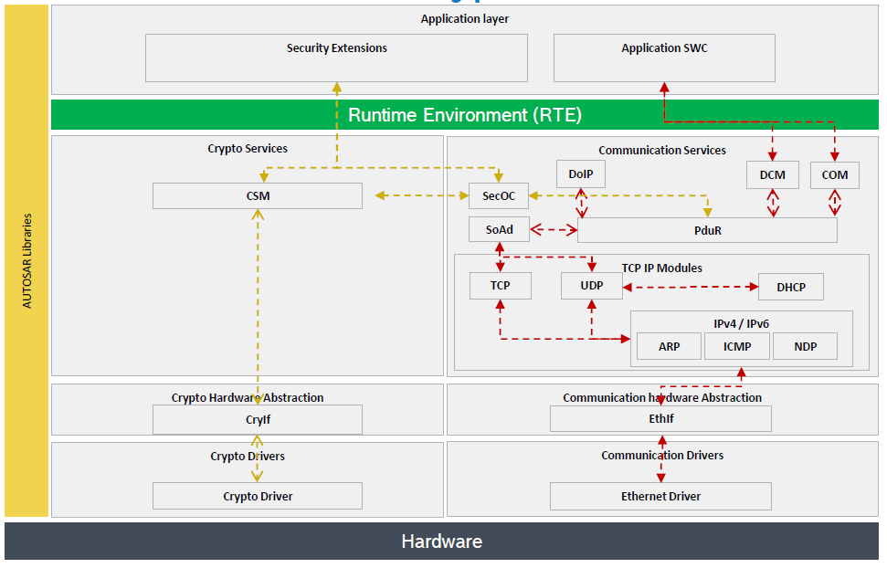
Crypto stack overview
Crypto stack and COM stack
12

Slide 13
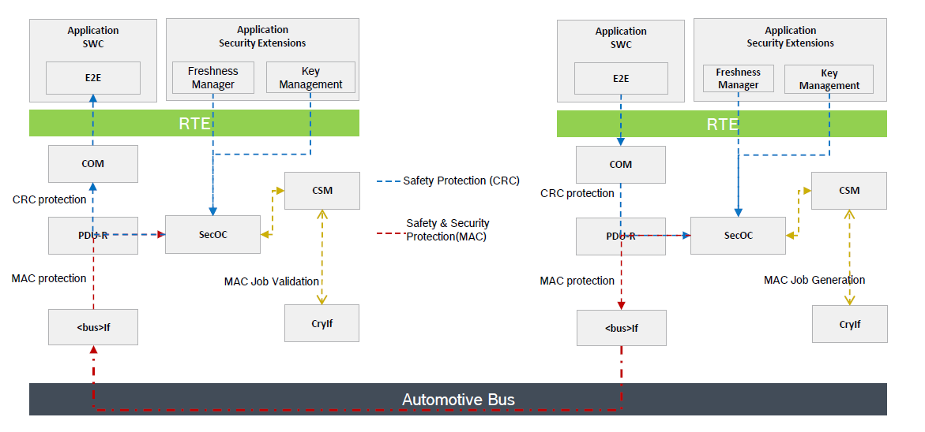
Crypto stack overview
Secure Onboard Communication
13

Slide 14
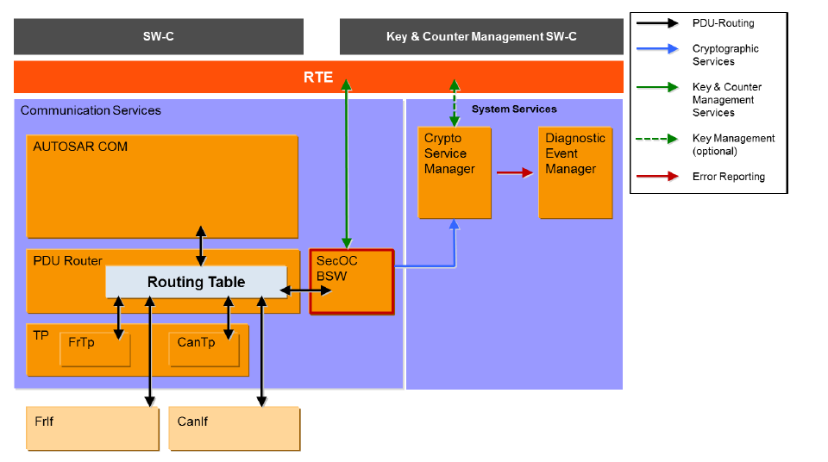
Crypto stack overview
Secure Onboard Communication
The SecOC module provides functionality necessary to verify the authenticity, integrity and freshness of PDU based communication between ECUs within the vehicle architecture.
The approach requires both the sending ECU and the receiving ECU to implement a SecOC module.
SecOC module integrates on the level of PduR.
Key & Freshness Manager S/W-C concept is largely OEM driven (at vehicle level) and it is dependent on vehicle network architecture.
14

Slide 15
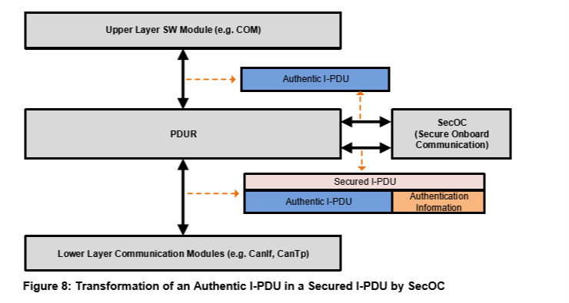
Crypto stack overview
Use case : Secure communication
PDUR receives one PDU from one specific channel (CAN, FlexRay, Ethernet).
PDUR transmits the PDU to SecOC, then SecOC converts this PDU to a “secure” PDU.
SecOC along with CSM verifies the PDU authenticity and integrity.
SecOC returns the PDU without security wrappers to PDUR to finish the PDU processing.
When SecOC determines that one PDU is insecure, SecOC discards the PDU, and PDUR receives nothing from SecOC.
SecOC communicates the PDU verification results to ASW.
Additionally, SecOC can support PDU data freshness.
13

Slide 16
Crypto stack overview
References
https://sandeeptiwari.com/crypto-services-in-autosar/#:~:text=Crypto%20Stack%20in%20AUTOSAR%20can,Random%20Numbers%20and%20Key%20Management.&text=This%20job%20is%20then%20referred,job%20id%20as%20a%20parameter
http://gearstech.com.mx/blog/2021/10/01/autosar-memory-service/
https://www.autosar.org/fileadmin/user_upload/standards/classic/4-3/AUTOSAR_EXP_UtilizationOfCryptoServices.pdf
https://www.autosar.org/fileadmin/user_upload/standards/classic/4-3/AUTOSAR_SWS_CryptoServiceManager.pdf
https://www.autosar.org/fileadmin/user_upload/standards/classic/20-11/AUTOSAR_SRS_CryptoStack.pdf
16

Slide 17

Crypto stack overview
QUESTIONS
16

Slide 18

Thank you!

